Slide 1
Machine Learning and its Implementation into Algorithmic Trading
Christopher De Leon & Jacob Steen

Slide 2
Overview
How to use K Nearest Neighbors (KNN) machine learning models in a trading algorithm and what impact does this have on returns?
Building a “vanilla” trading model
Only technical indicators
Create a KNN model and implement its decision making theory into a new backtest to compare returns

Slide 3
Building the Trading Algorithm
Created custom trading criteria using fast and slow moving averages
When the price succeeds the fast moving average, the algorithm signals a buy
When the price succeeds the slow moving average, the algorithm signals a sell
Using the Backtest.py python library, we tested our strategy using the State Street Financial S&P 500 ETF
Known as SPY
Parameters:
Fast Moving Average: 14 Days
Slow Moving Average: 35 Days

Slide 4
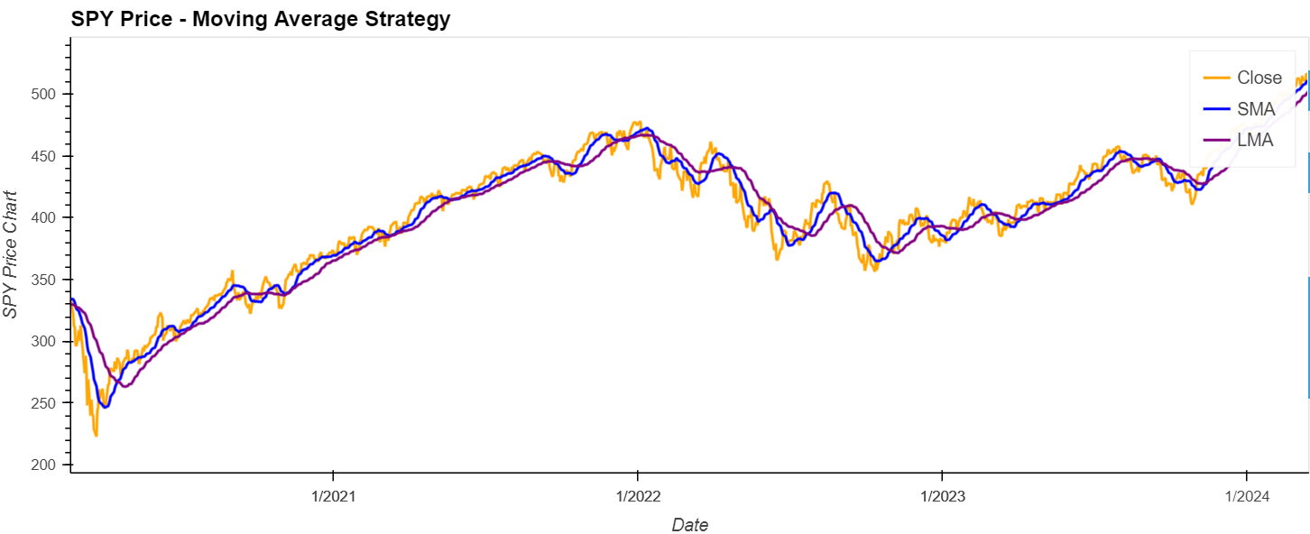

Slide 5
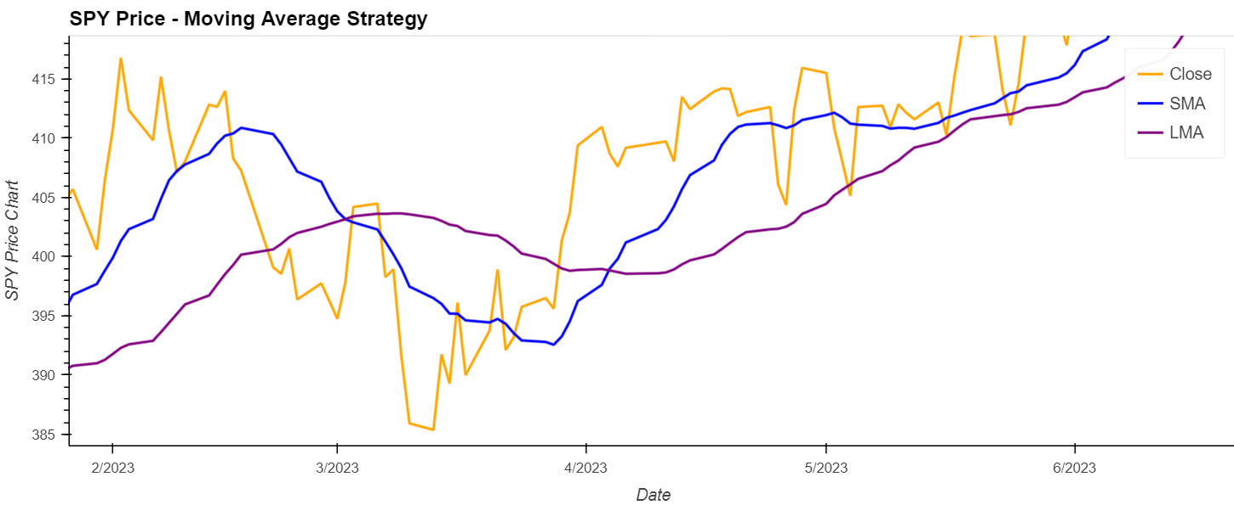

Slide 6
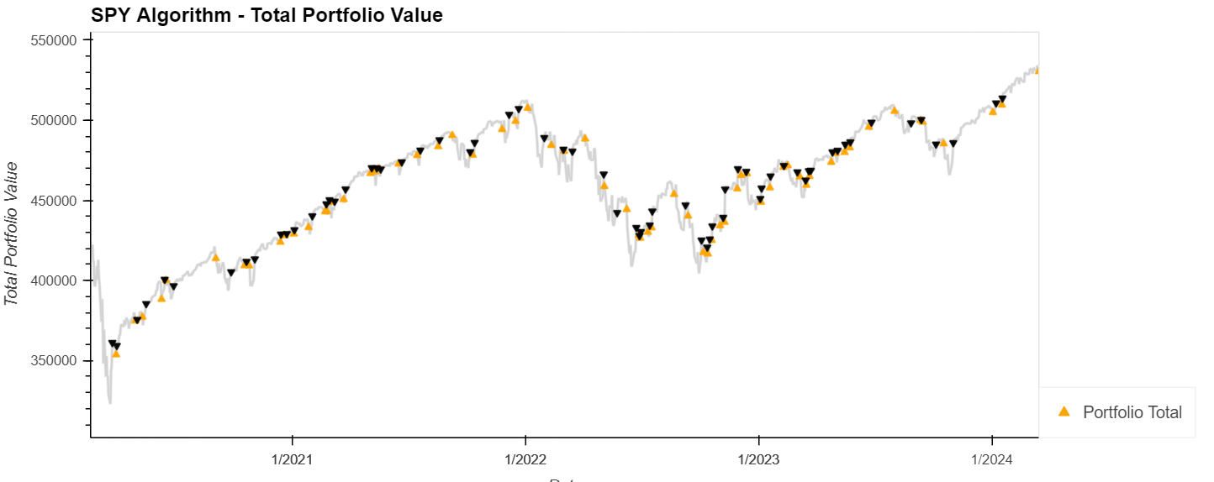

Slide 7
Algorithm Results
Our algorithm posted a return of 97.01% since January 1st, 2020
17.52% annualized
Sharpe ratio of 0.98
Risk-free considered 1.50
This sharpe ratio indicates that the algorithm takes too much risk given its returns and should be reevaluated.
Thus the need to apply machine learning to our algorithm in an attempt to boost performance

Slide 8
K Nearest Neighbors (KNN)
We chose to implement a K Nearest Neighbors model in our algorithm
KNN models work by grouping data in groups with similar characteristics
The hope is we would be able to group statistics for current candles and decide if the stock was grouped with other candles that were more prone for a breakout.
Thus signaling a buy
The vice versa is true for a sell signal

Slide 9
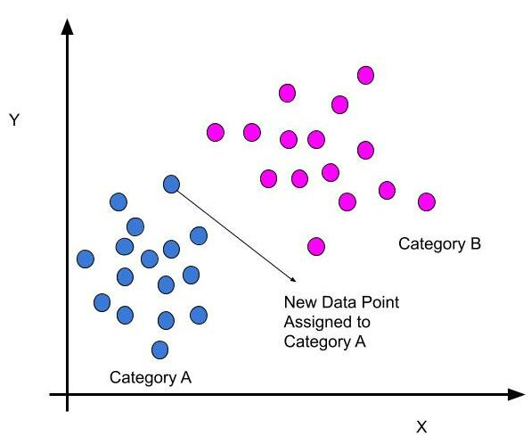
KNN Model logic is shown on the right.
Grouping is determined by where the dot falls on plot and the proximity of its neighbors
Thus earning the name K nearest Neighbors

Slide 10
Challenges with KNN Model
KNN Models use a random sampling technique
This was worked around to create a sequentially dated model
The model didn’t improve our returns.
It had very negative impacts on our returns and no longer beat the market

Slide 11
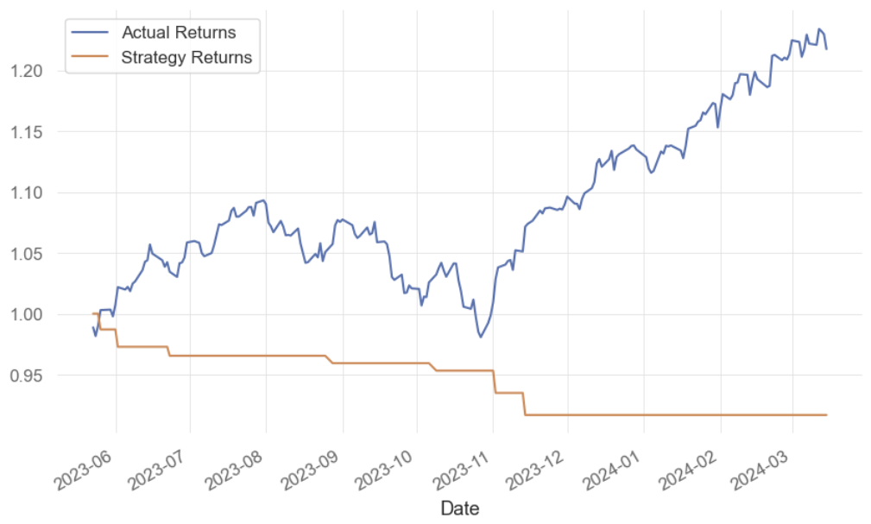

Slide 12
Improvements to be made
Different securities and parameters could be used to improve performance
Using a different kind of model which tracks momentum on a rolling window to better cluster our data
Change parameters or add other technical indicators
Slope of a line on a rolling window

